Slide 1
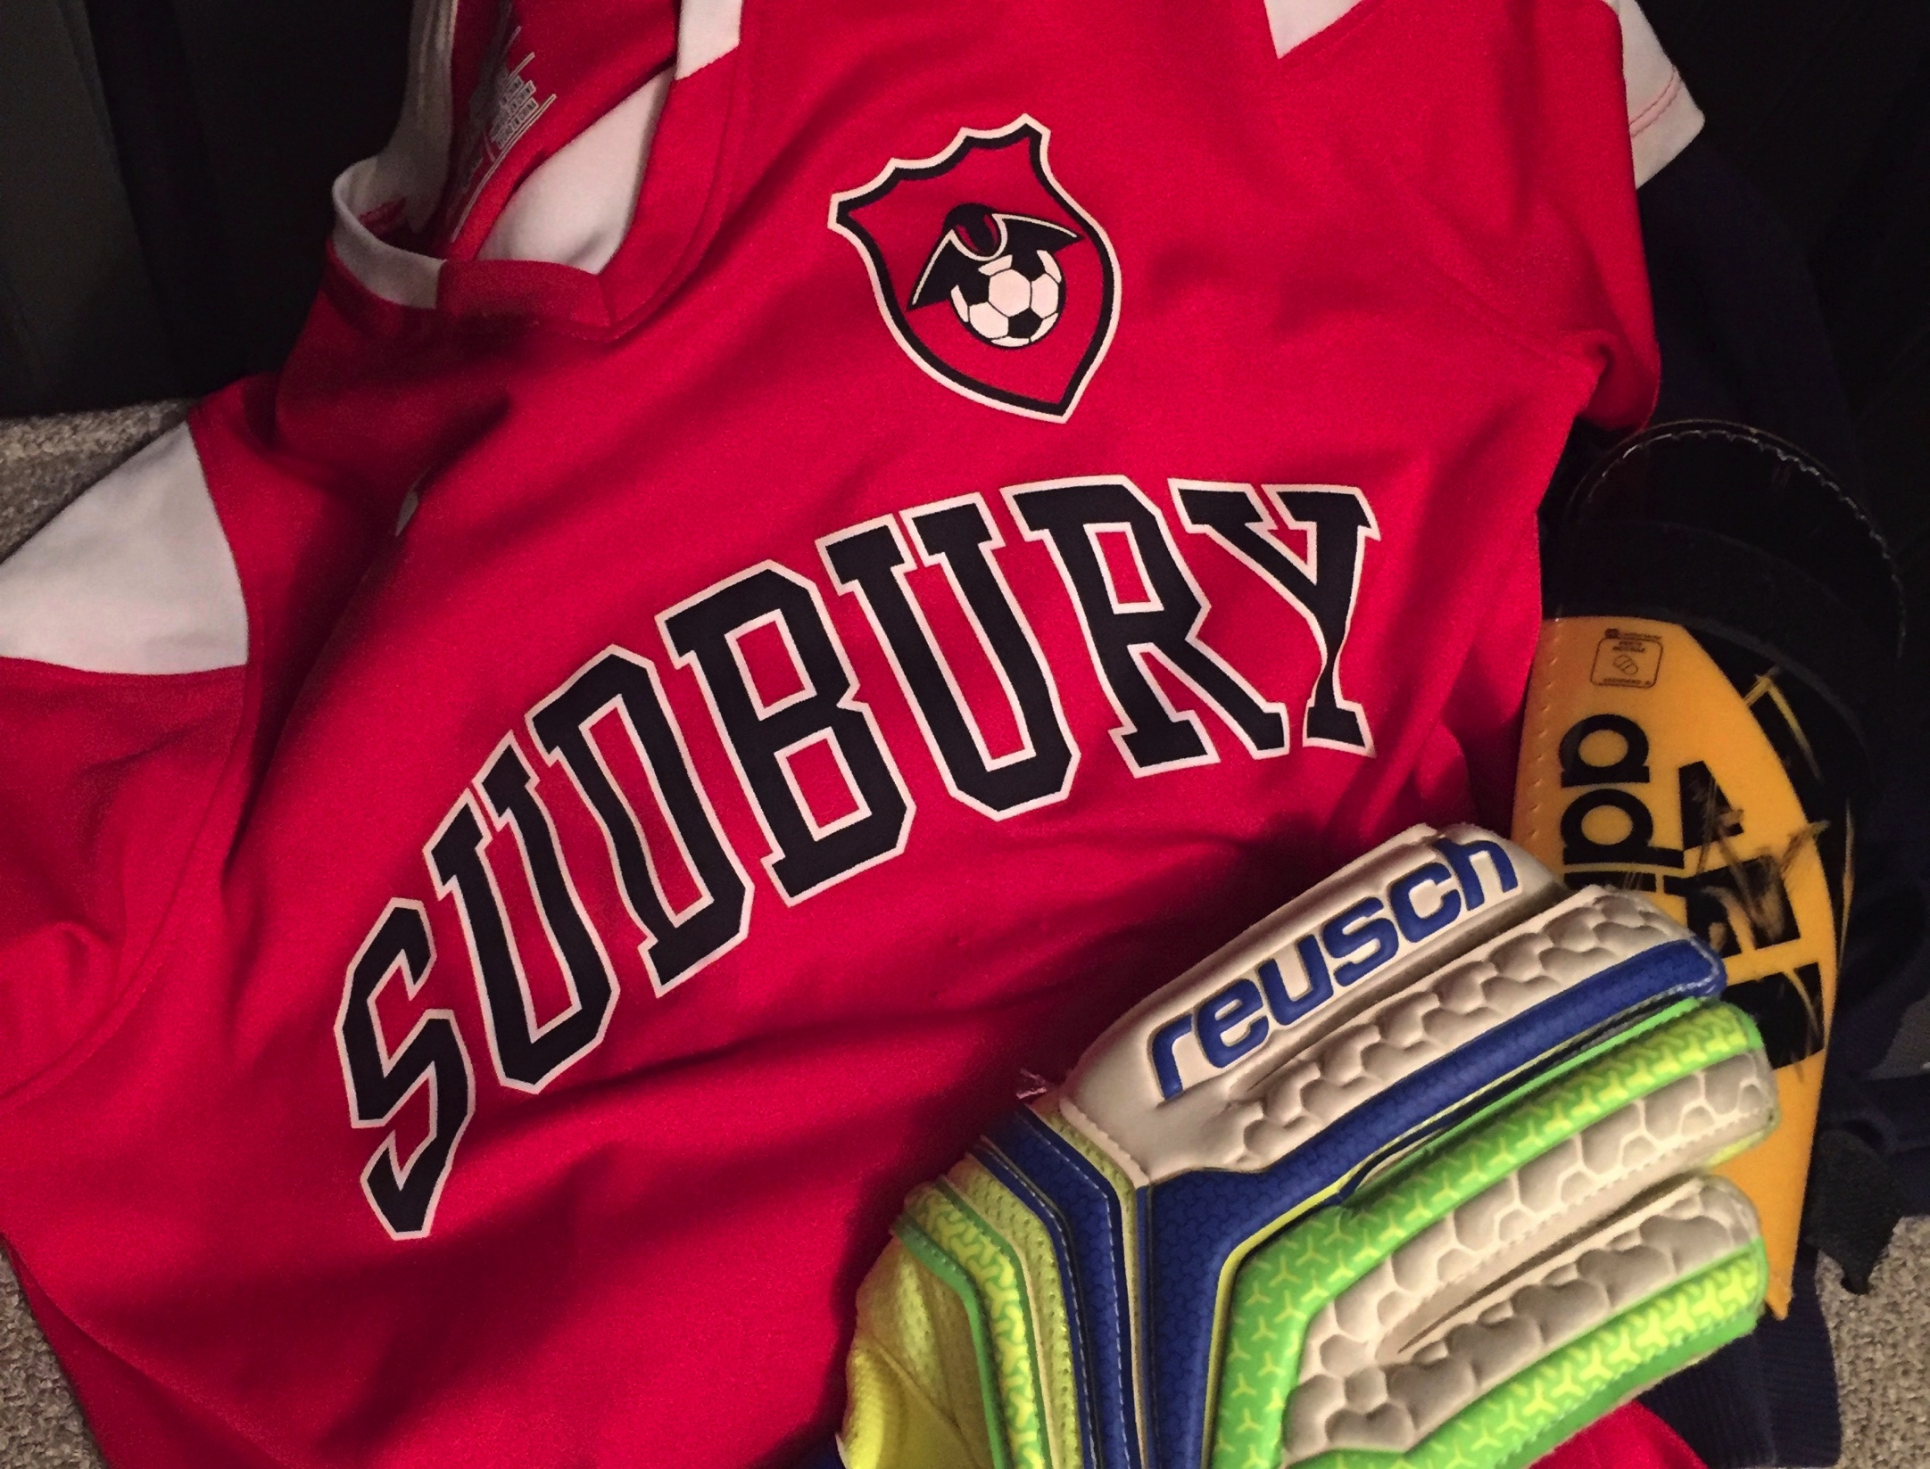
Sudbury Youth Soccer
Spring 2018 Coaches Meeting

Slide 2

Field Closures
Youth Soccer League (BAYS).
Welcome
Tonight’s Agenda:
Welcome and New Items – Bob Lee, President
Administrative Topics – Sandy Moore, Administrative Director
Executive Board Elections – Heather Tavolieri, Secretary
New Website, New Communication Methods, Social Media and Team Snap Refresher– Hartley Johnson, Communications/Technology
Questions and Comments

Slide 3

Field Closures
Youth Soccer League (BAYS).
Welcome
Thank you for volunteering to coach youth soccer this season. You are our most important resource!
Notes:
You are the life blood of this program!
Our goal is to provide you with the resources and training to help you make this a fun and learning activity for the kids
Ross will cover this in more detail later
You don’t need to be Will Farrell to make it fun for the kids!
You don’t need to be blessed with Messi’s skill and abilities to teach soccer

Slide 4

Field Closures
Youth Soccer League (BAYS).
Welcome
You are the key to communicating our philosophies with the players on your team and their families. You are a reflection of the program!
Notes:
You are the first line of communication with the players and parents, we want to make sure you have the correct information. Don’t be afraid to call, email or stop one of us and ask about the programs, how to handle a situation, anything!
What you say, do and how you act is a reflection on you and the program
Be positive and have fun
Leave your work and stress off the field, whether it’s practice or a game!

Slide 5

Zero Tolerance Policy
Youth Soccer League (BAYS).
Zero Tolerance
Zero Tolerance & Sportsmanship
50-100 issues per season in BAYS
No one, except the players, is to speak to the referee during or after the game!
Exceptions:
  •Coaches may ask questions before the game
  • Coaches may call for substitutions
  • Coaches may point out emergencies during the game
  • Coaches may respond to the referee if addressed
Notes:
Get the message out to the parents before the season
This starts with Kindergarten coaches, parents and players!
No one, except the players, can speak to the referee before or after the game about the call of the game
No yelling, criticism, harassment, sarcasm, intimidation or feedback
Violators can be ejected from the field
Coaches and teams are subject to disciplinary action by the BAYS Sportsmanship Review Committee

Slide 6
Zero Tolerance Policy
Youth Soccer League (BAYS).
Before Game Questions
Questions to Ask Referees Before a BAYS Game (Gr 3-8)
How long are the halves and how much time for the half?
Are we playing offside/punts over half/clear the half for a goal kick?
Heading the ball results in an Indirect Free Kick, will you play advantage?

Slide 7

BAYS Coach Pass Cards
Youth Soccer League (BAYS).
SYSA Night at the Revolution
May 19th vs. Columbus Columbus Crew
Details and ordering links to be sent by email soon!
Dedicated parking at Empower Fieldhouse
Pregame activities and small sided games inside Empower Fieldhouse for SYSA players
Reduced ticket prices ($28 each)in part of a midfield section for SYSA families using promotion code SUDBURY18
Always a fun evening for the whole family with fellow SYSA families.

Slide 8
Field Closures
Youth Soccer League (BAYS).
Tonight’s Agenda:
Welcome and New Items – Bob Lee, President
Administrative Topics – Sandy Moore, Administrative Director
Executive Board Elections – Heather Tavolieri, Secretary
New Website, New Communication Methods, Social Media and Team Snap Refresher– Hartley Johnson, Communications/Technology
Questions and Comments

Slide 9
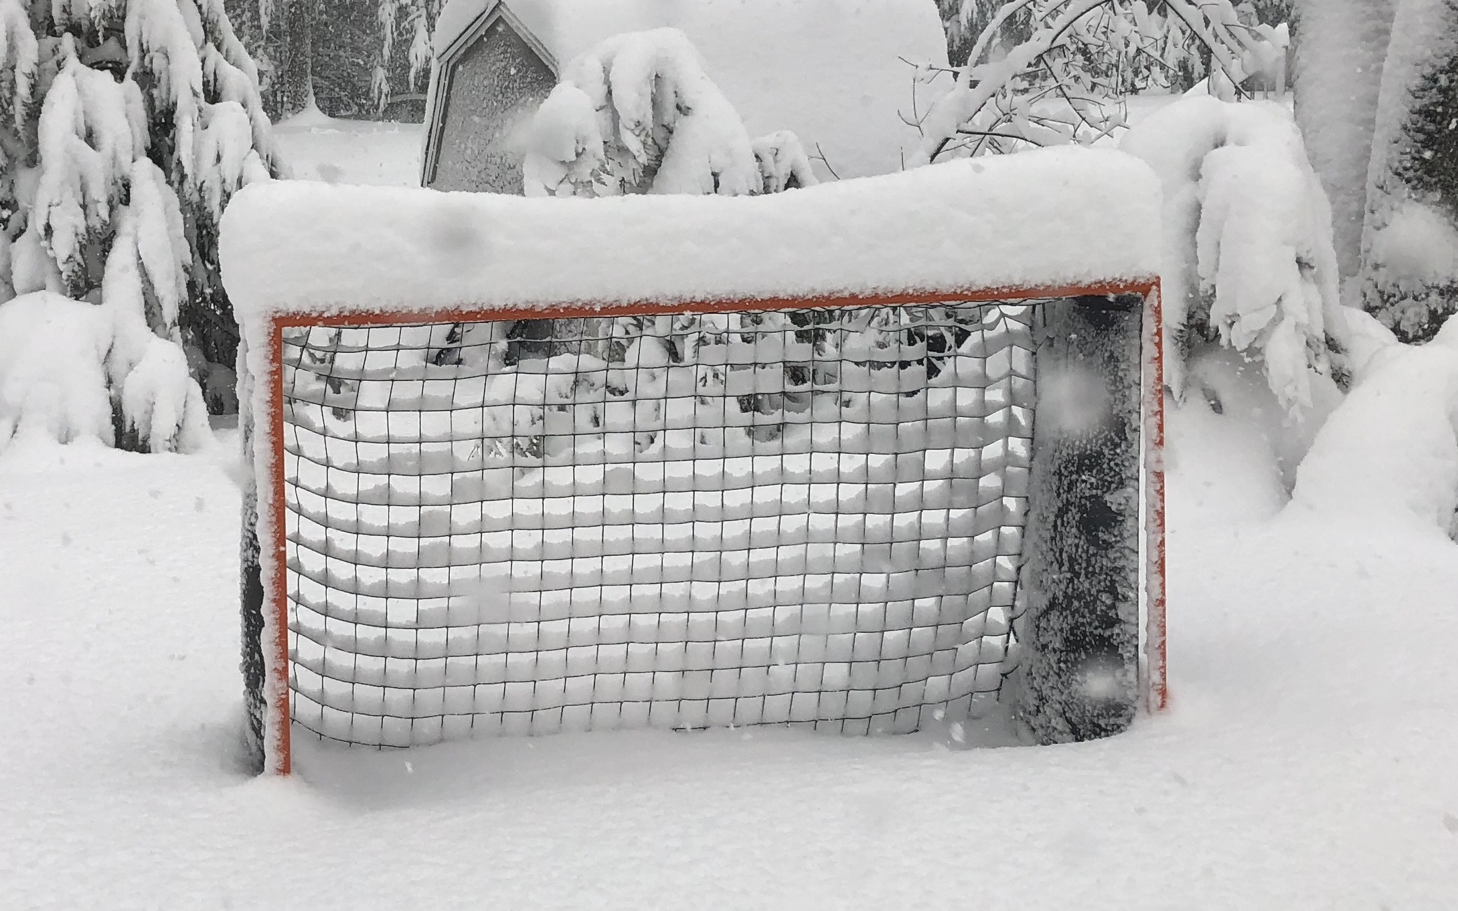
Youth Soccer League (BAYS).
Spring 2018 Schedule
3rd – 8th Grade BAYS:
  Practices, Group Nights & Skills League start April 2nd
  First games – April 7th
  Games scheduled for Memorial Day Weekend
  Season ends – June 10th
  All weather permitting!
  **All Weather Permitting!!**

Slide 10
Youth Soccer League (BAYS).
Spring 2018 Schedule
Kindergarten and First Grade:
  Season starts – April 14th and 15th
  No games Memorial Day Weekend (May 26 and 27)
  Season ends – June 16th and 17th
Second Grade:
  Practices, Group Nights & Skills League start April 2nd
  First games – April 14th
  No games Memorial Day Weekend (May 26 and 27)
  Season ends – June 17th

Slide 11

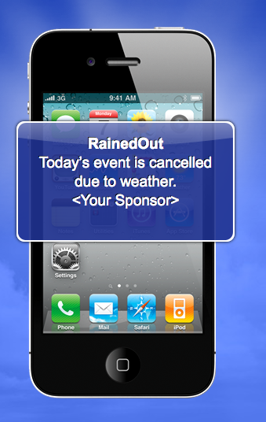
Field Closures
Youth Soccer League (BAYS).
Field Closures
Check SYSA website home page (top left)
Subscribe to RainedOut - No charge
Receive Field Status updates directly to your cell www.rainedout.com or Text SUDBURY to 70359
Free service, standard test messaging rates apply

Slide 12
Field Closures
Youth Soccer League (BAYS).
Field Information
All grass fields open on April 2nd (weather permitting)
Turf field restrictions:
  Only players, coaches & referees on the field
  No spectators allowed on the field
  Only water is allowed, no juice, Gatorade or food
  No tents, canopies, or umbrellas that penetrate the turf
Goals:
  Do not move the goals at Haskell under any circumstances
  Goals must be sandbagged on the turf fields
  Check the nets frequently and report issues right away
  Do not let players hang on the crossbars

Slide 13
Coach Requirements - CORI Forms
Youth Soccer League (BAYS).
CORI Background Check
Need to Submit a CORI?
Sign on to Mass Youth Soccer
  http://www.mayouthsoccer.org/members/adult registration
After completing the CORI Registration, print out the Mandatory CORI Submission Form using the Print Form button
Present the original CORI Form in person to the SYSA CORI Submitter
Provide your license or other government issued ID with photo
Both you and the Submitter must sign the form in blue or black ink
The CORI Submitter will then keep the original CORI form on file

Slide 14
Coach Requirements –
Concussion Education
Youth Soccer League (BAYS).
Concussion Training
All coaches must complete Concussion Training by watching one of the videos below once every two years.
National Federation of State High School Association
  http://nfhslearn.com/courses/61037
Centers for Disease Control and Prevention
  http://www.cdc.gov/concussion/HeadsUp/Training/index.html
BAYS coaches send a copy of the certificate to SYSA by emailing Sandy (admin@sudburysoccer.org). Make sure to include your name in the file title (i.e. Moore-Concussion).

Slide 15
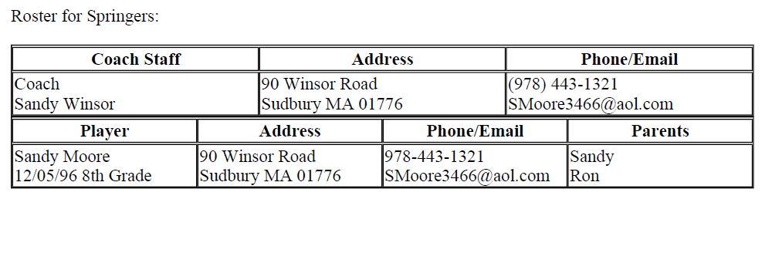
uLittle and SSL In Town Rosters
Youth Soccer League (BAYS).
Kindergarten – 2nd Grade Rosters
Player contact information received via email
Print a single copy and put into gear bag

Slide 16
BAYS Travel Team Rosters
Youth Soccer League (BAYS).
BAYS Rosters (Grades 3-8)
Official roster sent via email
Sign and fill in jersey numbers
Bring TWO copies to each game
Official copy sent to BAYS director by SYSA
Coaches can not make changes to the official roster
Contact Sandy if you need any special rosters for tournaments or other non-BAYS games

Slide 17
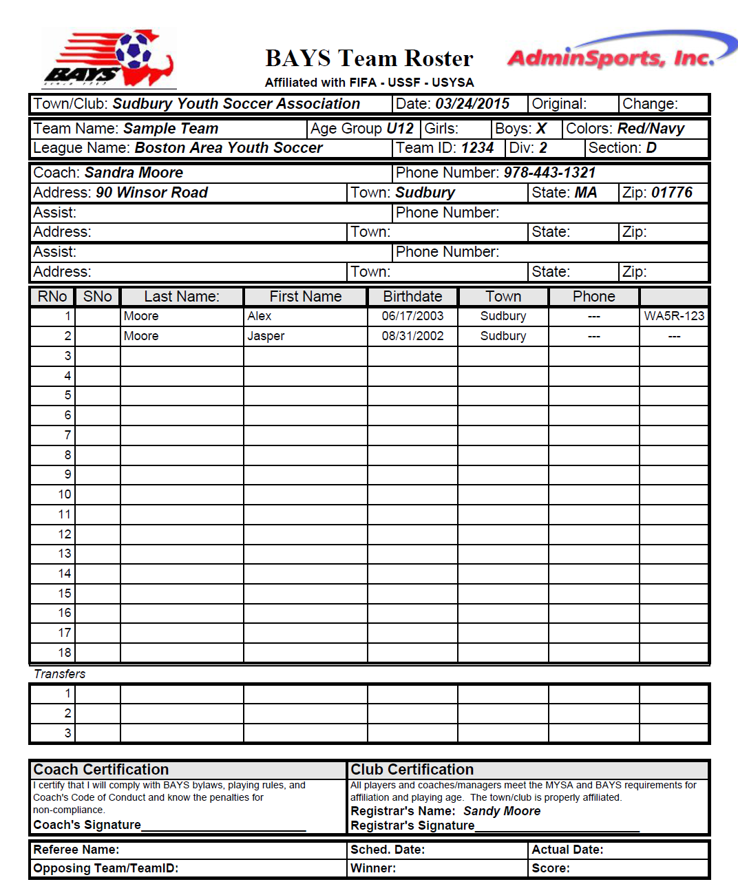

BAYS Rosters
Youth Soccer League (BAYS).
Official BAYS Roster
Coach must sign roster
SYSA Club certification: Sandy’s printed name acts as official signature
Roster needs to have the BAYS stamp on it
BAYS waiver number

Slide 18
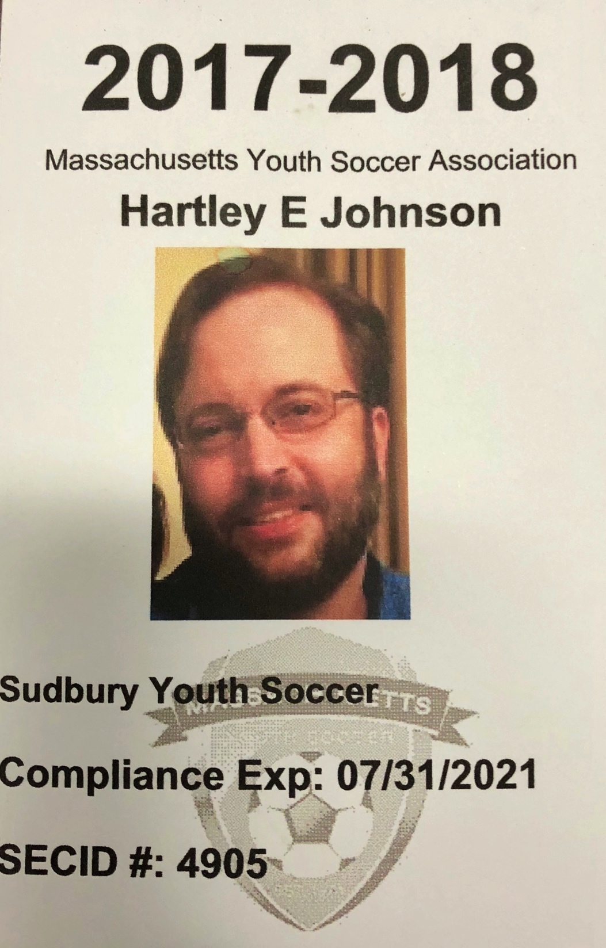
BAYS Coach Pass Cards
Youth Soccer League (BAYS).
MYSA Coach ID Cards
ID cards are required for all coaches & assistant coaches
Required to be worn at ALL practices and games
4” x 6.5” cards can be placed in provided plastic sleeve with blue lanyard

Slide 19
BAYS Coach Pass Cards
Youth Soccer League (BAYS).
BAYS Coach Cards
Changes for Spring 2018 with traditional BAYS Coach Cards.
Only MYSA credentials are required. The BAYS pass cards are being phased out and are optional.
SYSA recommends having both at games. The referee may choose to hold your pass card.

Slide 20
Zero Tolerance Policy
Youth Soccer League (BAYS).
BAYS Player Pass Cards
Player pass cards required for all MTOC teams
Grades 6 - 10 Divisions 1 & 2, and Grade 12 Division 1
Players must upload picture to AdminSports registration page

Slide 21
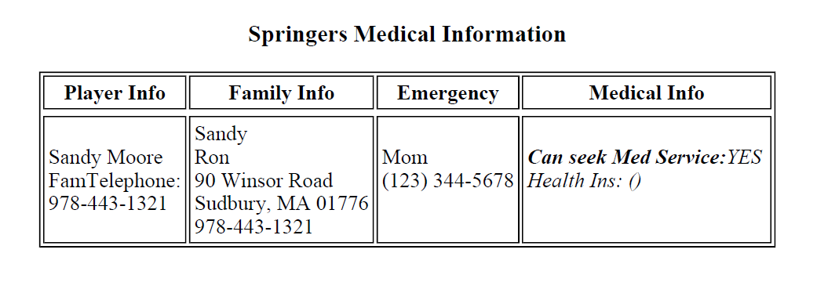
Medical Releases & Player Summary
Youth Soccer League (BAYS).
Medical Release
Always have medical releases for ALL players at ALL times
  Put copies in your gear bag
  Forms will be sent to you via email
Notes:
Insert medical release form

Slide 22
BAYS Coach Pass Cards
Youth Soccer League (BAYS).
Equipment Details
What equipment should coaches have?
  Balls, cones, pinnies, first aid kit, pump…
  See www.sudburysoccer.org > Coaches > Equipment
How do I get or return equipment?
  Email equipment@sudburysoccer.org
  First aid supplies and ice packs can be taken from the trailer at Haskell whenever you need them.
Goals (Pugg Nets) for Kindergarten and 1st Grade
  Kept in the trailer and delivered by Revs coaches
Goals (Samba) for 2nd Grade
  Kept in the pen next to the trailer
  The pen should be opened before games
  Teams that play first set them up
  Teams that play last return them and lock the pen

Slide 23
BAYS Coach Pass Cards
Youth Soccer League (BAYS).
Equipment Details
How can you help?
  Let us know if nets or goals need to be repaired
  Take care of the gear.
  Periodically wash pinnies and goalkeeper gloves
  When done with your gear bag, remove all non-SYSA equipment before returning it

Slide 24
Field Closures
Youth Soccer League (BAYS).
Tonight’s Agenda:
Welcome and New Items – Bob Lee, President
Administrative Topics – Sandy Moore, Administrative Director
Executive Board Elections – Heather Tavolieri, Secretary
New Website, New Communication Methods, Social Media and Team Snap Refresher– Hartley Johnson, Communications/Technology
Questions and Comments

Slide 25
Zero Tolerance Policy
Youth Soccer League (BAYS).
Slate of SYSA Exec. Officers
Confirm by a show of hands approval of the slate of
officers for a one year term, 2018-2019.
President – Robert Lee
VP Girls – John Simon
VP Boys – Chris McClure
VP K-2nd – Bryan Gothie
VP Academy – Matt Reece
Treasurer – Chris Johnson
Secretary – Heather Tavolieri
VP Marketing – Suzanne Konigsberg
VP Communications/Tech – Hartley Johnson

Slide 26
Field Closures
Youth Soccer League (BAYS).
Tonight’s Agenda:
Welcome and New Items – Bob Lee, President
Administrative Topics – Sandy Moore, Administrative Director
Executive Board Elections – Heather Tavolieri, Secretary
New Website, New Communication Methods, Social Media and Team Snap Refresher– Hartley Johnson, Communications/Technology
Questions and Comments

Slide 27
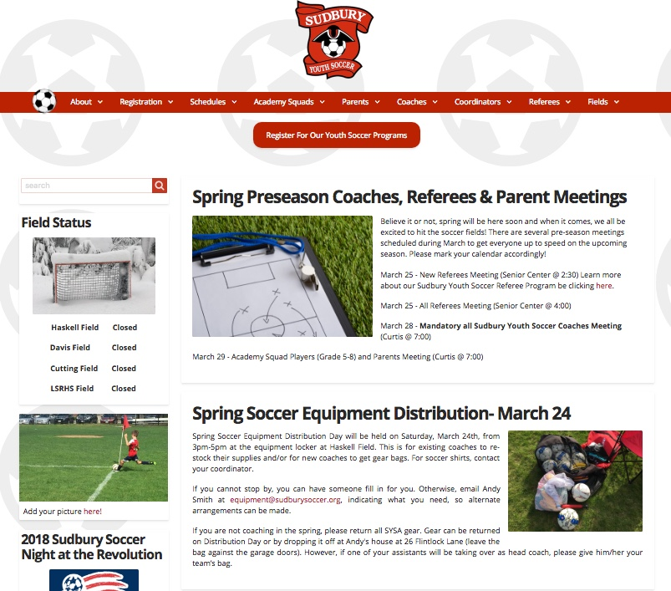
Youth Soccer League (BAYS).
Our New Website, sudburysoccer.org!
New for 2018, redesigned modern website. Easy to view on all devices
Clearly designed with focus areas for parents, coaches, referees
Clear schedules, registration portal and important articles
Coaches, please submit your soccer pictures
If you haven’t visited lately, check it out!

Slide 28



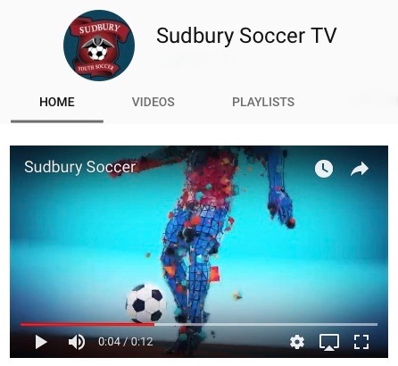

Youth Soccer League (BAYS).
Communications / Social Media
Targeted communications through Constant Contact
Easy to read emails for mobile devices
Visually more appealing and easier to navigate
Follow SYSA on Facebook, Instagram and YouTube
Academy Games on Sudbury Soccer TV
Links to our social media platforms are on the website footer

Slide 29



Field Closures
A TeamSnap Refresher
Youth Soccer League (BAYS).
Introduced last spring, TeamSnap is a helpful
sports team/league management platform designed to:
Manage your team schedule
Track player availability
Enable real-time team communication
Create parent assignments (snack duty)
Allow communication between Technical Director and Coaches
**As a coach, you will be part of two TeamSnap “Teams”, your team and your grade level/gender**

Slide 30
Field Closures
A TeamSnap Refresher
Youth Soccer League (BAYS).
  For Spring 2018 season, notifications from Ross and Revolution Academy Coaches regarding Group Nights will be done via TeamSnap.
  Make sure to accept his invitation when you receive it. This allows you to receive his weekly emails and differs from your link to your specific team.
  Though not mandatory, it is highly recommended to use Team Snap with your team this season. When you receive the invitation as coach, your roster will be populated for you by SYSA.
    Your roster will include the following: (player name, family contact email/phone, address and emergency contact)
    To complete your team, you will need to fill in your team schedule (practices and games) and snack assignments

Slide 31
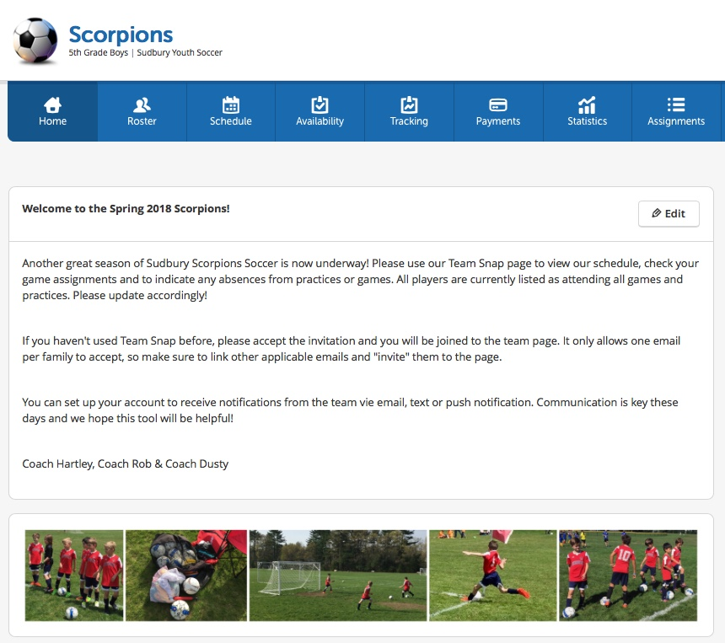
Field Closures
How Do I Get Started?
Youth Soccer League (BAYS).
Accept your invitation as Coach/Asst. Coach of your team. If previously assigned a team, simply log in to your account.
Select the Roster Tab and click invite to join on all the populated players
Add introductory info and coaches welcome on the team homepage

Slide 32
Field Closures
Completing Your Team
Youth Soccer League (BAYS).
Create your training and game Schedule (enter game address, arrival time, field #)
Add Assignments (oranges/popsicles)
Invite families to review Availability tab and list any know absences for game planning
Email families with ease using the Messages tab

Slide 33
Any Questions?

