Slide 1
SYSA Travel Evaluation Guide
2019
Evaluation sheets for the travel evaluation nights.

Slide 2
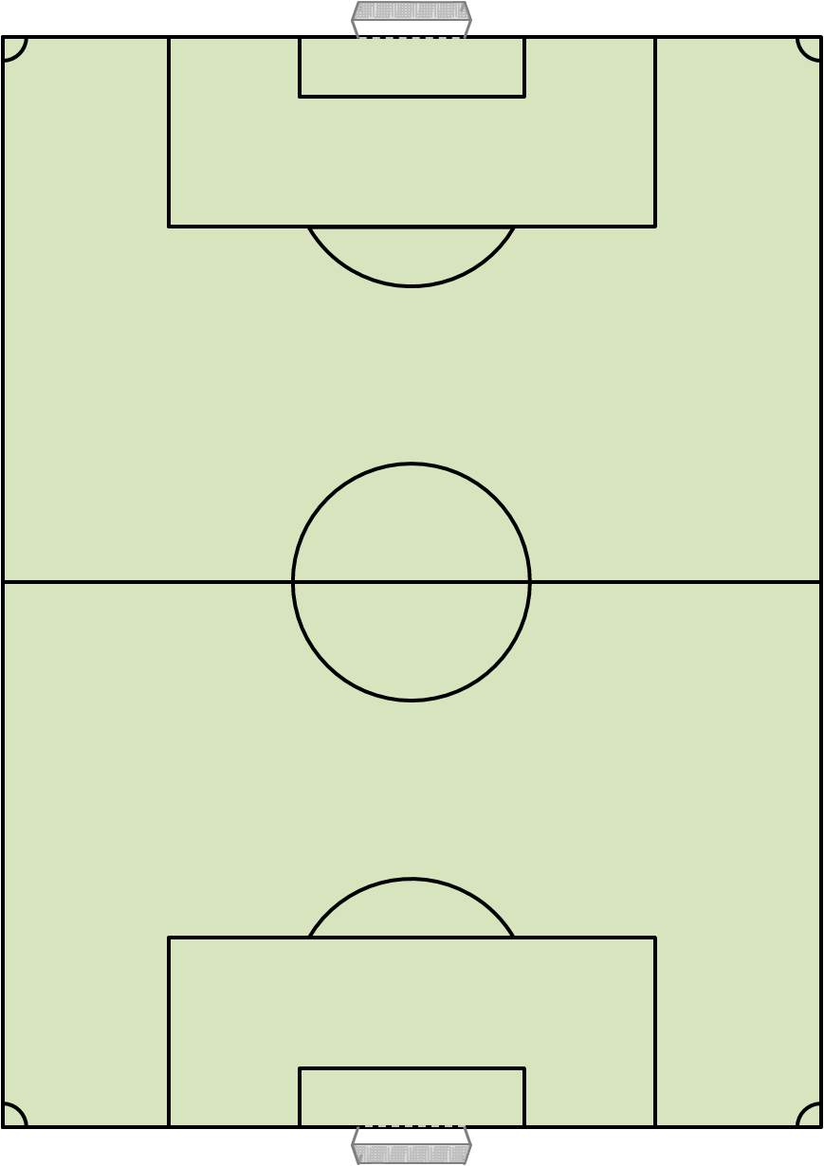
Station 1 – End Zone Soccer
A | First Touch
B | Dribbling
Objective: To dribble over your opponents end line.
Rules: Regular game with a point being scored for dribbling over your opponents end line.
Player | A | B | Total
1 = Low to 6 = High

Slide 3
Station 2 – Four Goal Game
A | First Touch
B | Passing
Objective: To penetrate your opponents gate.
Rules: Regular game with a point being scored for dribbling through your opponents goal.
Player | A | B | Total
1 = Low to 6 = High

Slide 4
Station 3 – 4v4 Game
A | Finishing
B | General Movement
Objective: To score in you opponents goal
Rules: Regular 4v4 game.
Player | A | B | Total
1 = Low to 6 = High

Slide 5
Station 4 – 1-0 Game
A | General Technique
B | Finding Space
Objective: To score in you opponents goal
Rules: Regular game until a team scores a goal, once a team leads 1-0 they must sit in possession (not allowed to score). Once the opponents score the game starts again.
Player | A | B | Total
1 = Low to 6 = High

Slide 6
Station 5 – Tempo Game
A | First Touch
B | Passing
Objective: To score in you opponents goal
Rules: Regular game with a zone in the middle. Tempo of game should increase and players are encouraged to play 1st time passes (it s not a foul if they don’t.)
Player | A | B | Total
1 = Low to 6 = High

Slide 7
Station 6 – Counter Goals
A | Defending 1v1
B | Defending as part of a team
Objective: Attackers must score in the goal and defenders must penetrate the attackers counter goal
Rules: Modified field with 1 goal and 2 counter gates. After a goal is scored in either end the players change roles.
Player | A | B | Total
1 = Low to 6 = High

Slide 8
Evaluation Night 2
A | Technical | B | Tactical
C | Physical | D | Psychological
Player | A | B | C | D | Total | FR
1 = Low to 6 = High

